Slide 1
HANDWRITTEN TABLE EXTRACTION OCR
Project By: Natasha Salvi
Intern @ Software Integration Dept, IITPL

Slide 2
INTRODUCTION
Problem statement: This project aims to digitize handwritten traceability documents, directly into an excel sheet, thus reducing manual effort.
It processes scanned images of handwritten tables to automatically detect and recognize the tabular structure and content. It utilizes pretrained OCR models to accurately read handwritten entries and fill in an Excel sheet, mirroring the original layout. This project significantly reduces physical data entry effort and improves efficiency in handling handwritten documents.
[Note: This is a primary version, increasing the accuracy and efficiency can be further worked upon.]

Slide 3
TIMELINE
The process began with using pytesseract, but it resulted in low accuracy for handwritten text.
The next step was to find an OCR model to train on the IAM dataset for a more precise prediction of handwritten data.
Ultimately due to certain constraints, it had been decided to progress further by making use of a pretrained model (trOCR).
Lastly, to mirror the tabular structure into excel, instead of detecting text regions (using easyOCR), it was decided to detect the cell boundaries (using img2table) for the best possible outcome.

Slide 4
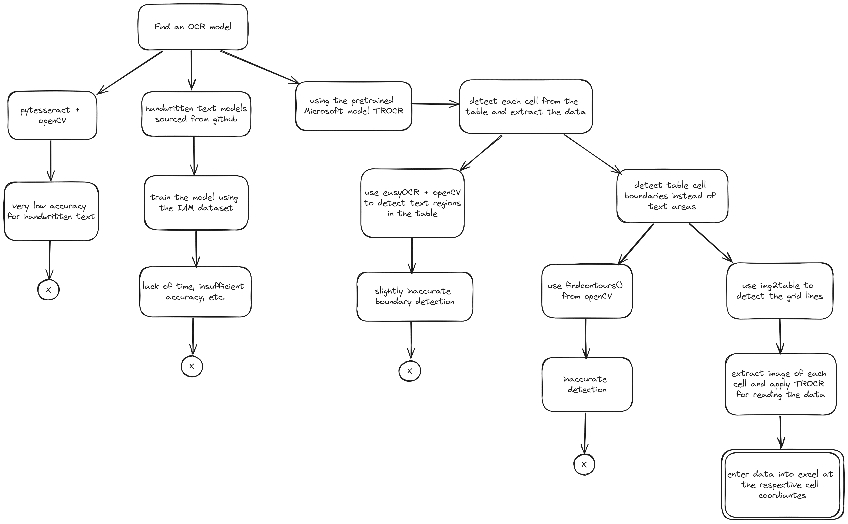

Slide 5
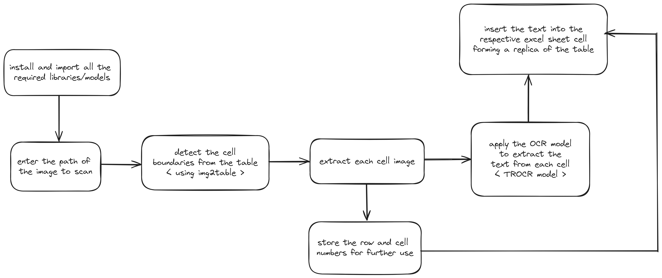
DATA FLOW DIAGRAM

Slide 6
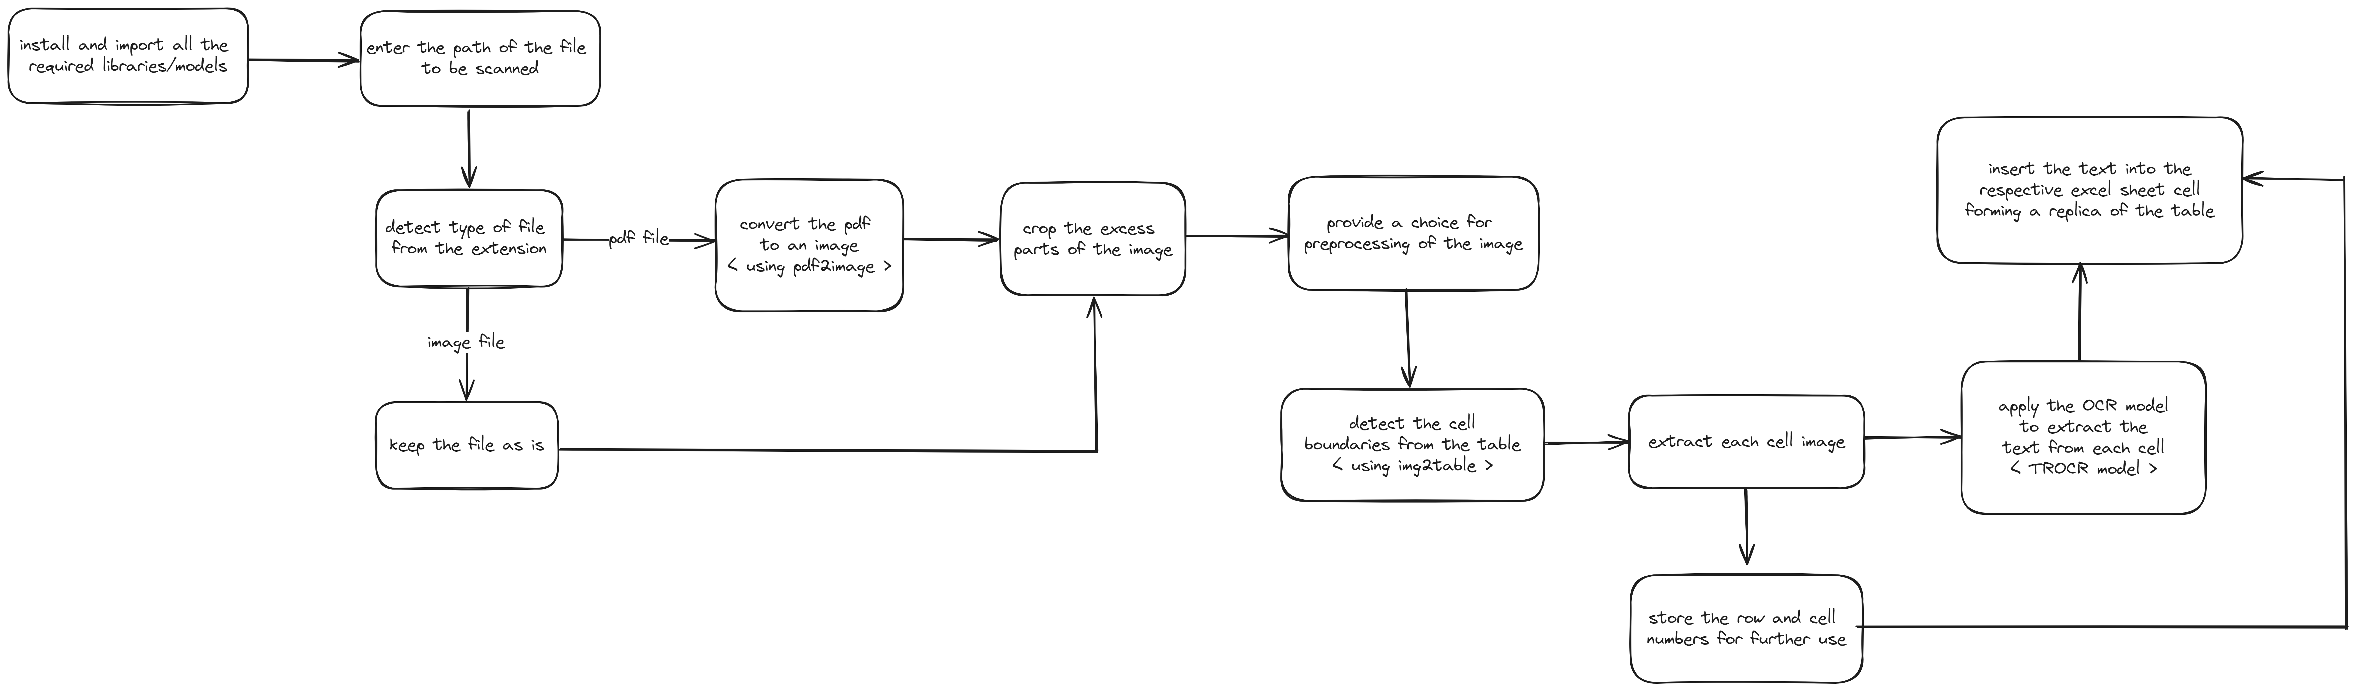
DATA FLOW DIAGRAM (updated)

Slide 7
MODELS USED
Pretrained model used for text recognition: TROCR
The TROCR model is a pretrained encoder-decoder model, consisting of an image Transformer as encoder, and a text Transformer as decoder.
Model used for tabular structure detection: IMG2TABLE
img2table is a simple, table identification and extraction Python Library based on OpenCV image processing that supports many common image file formats.

Slide 8
REQUIREMENTS
Installations required to run the code successfully:
openpyxl
transformers
pandas
img2table
Python 3.10.12

Slide 9
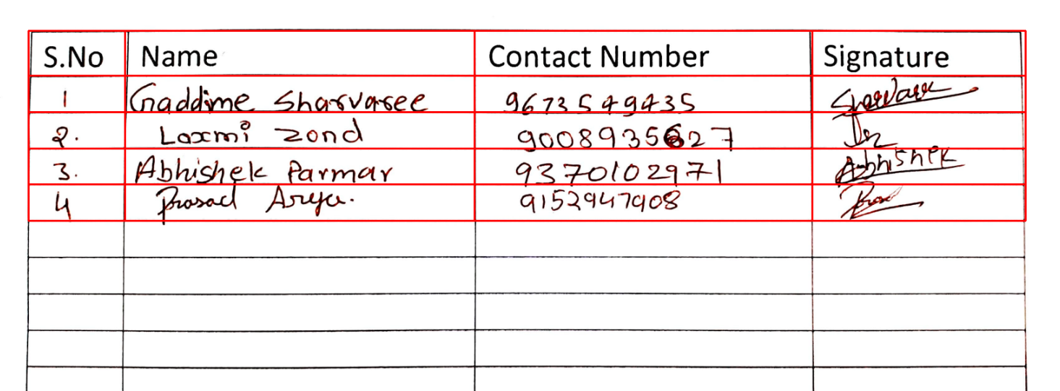
OUTPUT

Slide 10
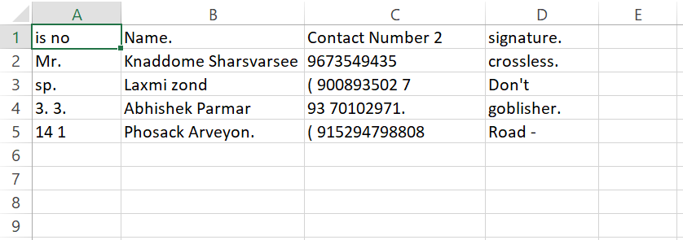
OUTPUT

Slide 11
ACCURACY, LIMITATIONS AND FUTURE SCOPE
The current accuracy of the program is roughly 70%. It can be further improved by substituting the pretrained model used, with a model that is actively trained using the IAM dataset, or by uptraining the current model given the time and resources.
The current implementation of the code runs efficiently on powerful GPU machines in Google Colab but takes longer to execute on a local Jupyter notebook. As this is a preliminary version, future improvements can be made by optimizing and testing the code on a PC with a robust GPU to enhance performance.
There is one anomaly that occurs when the table is unable to identify a cell in the table resulting in a NULL value being returned, which causes an error to spring up. This error has been temporarily handled by replacing the unrecognized text with a blank “ ” to avoid the program from abruptly stopping, and ensure its smooth completion.

Slide 12
UPDATES MADE FOR VERSION 2
This program is now capable of handling pdf files as well as image (.jpg, .png, .jpeg) files. It automatically detects the file type and performs the respective procedure.
The images extracted from the pdf file are also auto-cropped, to increase the clarity and accuracy.
The images obtained are now also preprocessed to increase the accuracy even further.

Slide 13
CONCLUSION
As we can see, the code works with roughly 70% accuracy and can be improved further.
The ultimate goal of this program is to decrease the effort and time spent on manual data entry.
This being a primary version, can be worked upon further in terms of improving efficiency, model accuracy, and more.
Git Link: Table Extraction OCR

Slide 14
THANK YOU!

